Slide 1
Is Your Newsletter Telling Your Whole Story?
Or are there holes in your strategy?
Brandy M. Bivens, Director of Communications & Marketing

Slide 2
Email Newsletters: How is yours doing?

Slide 3
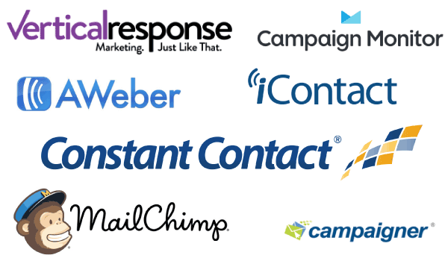
Best Practices for Email Marketing
Grow Your Traffic; Increase Your Presence; Spread Your Message!
Use an email platform!
  Easy to Use
  Templates: One and Done!
  Track and Manage Data
  Low/No Cost
  Improve Communication
  Privacy issues are easy(er) to handle

Slide 4
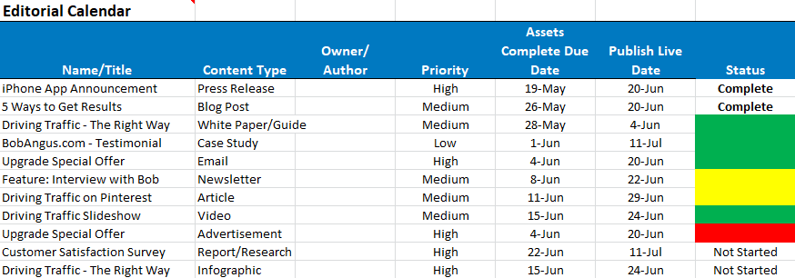
Best Practices for Email Marketing
Create a Content Calendar!
  Do the hard work – planning- once!
  Set deadlines to stay on track
  Creates consistency – publish regularly, on-time
  Synchronize with other sources

Slide 5
Best Practices for Email Marketing
Subject Lines are NOT an afterthought!
Does it stand out?
Use an emoji!
Is your Subject Line optimized?
EXAMPLES:
New Year? RESOLVE to … Open this email ☺ BOOM! Done!
This Collaborator edition will SLEIGH you. 🎄 Merry Christmas! 🎄
Hello Gourd-geous! A Fall Checklist for Your Church, Vetting Volunteers for Christmas, and More
Is your church really prepared for winter weather? How sure are you?
HANDY TOOL! https://coschedule.com/headline-analyzer

Slide 6
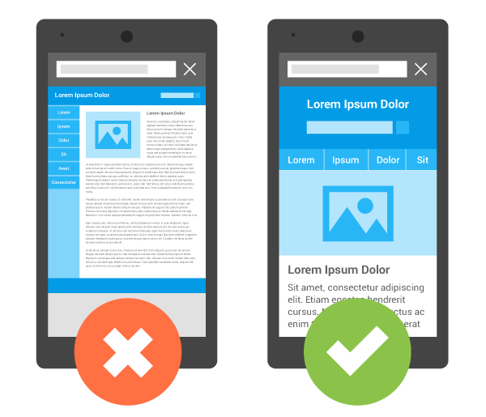
Best Practices for Email Marketing
OPTIMIZE, OPTIMIZE, OPTIMIZE!
½ of all emails are read on mobile devices
Make sure your design and subject lines are optimized
Email Platforms make this easy

Slide 7
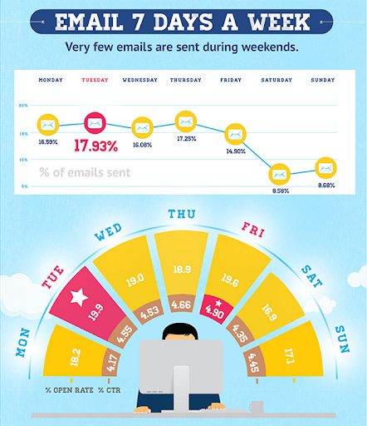
Best Practices for Email Marketing
Timing/Frequency
Too often = Unsubscribe
Too infrequent = overlooked
Conventional wisdom Tuesday a.m.
Now the platforms tell you when is optimal timing based on day you want to send
Experiment, crunch the data, set a time, stick with it!

Slide 8
Best Practices for Email Marketing
Timing/Frequency
Too often = Unsubscribe
Too infrequent = overlooked
Conventional wisdom Tuesday a.m.
Other option: between 8 a.m. – 9 a.m. Thursday
Experiment, crunch the data, set a time, stick with it!

Slide 9
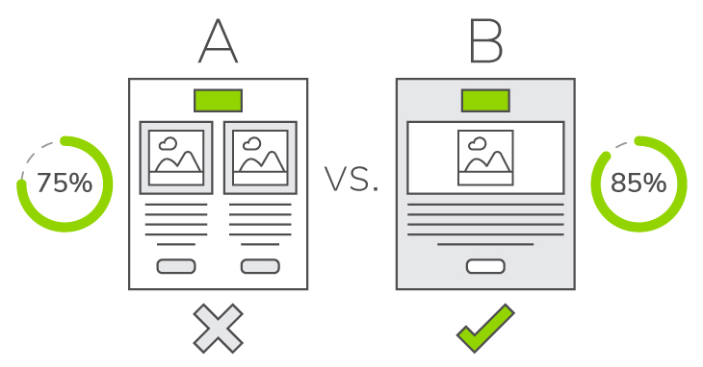
Best Practices for Email Marketing
Testing, Testing, One Two Three!
A/B Test!
Remain curious about what does and doesn’t work for your audience!

Slide 10
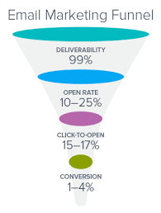
Best Practices for Email Marketing
Analyze!
Click thru rates, open rates, etc.
Questions: How many people are opening my email? How many people are engaging with my content? Is anyone following my call-to-action?

Slide 11
Brandy M. Bivens,
Director of Communications & Marketing
Thank you!
1908 Grand Avenue
Nashville,TN 37212
615-369-2338
bbivens@gcfa.org
www.umcsupport.org

