Slide 1
UMC Finance &
Administration
Training

Slide 2
Data Services

Slide 3
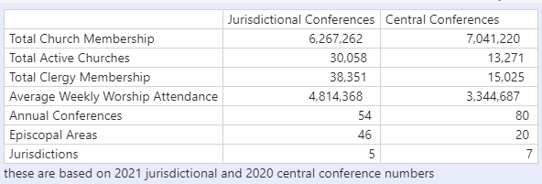
Central Conference / Jurisdictional Conference
ENG
Central conferences have surpassed the Jurisdictional Conferences in Total Church Membership
FRA
Les conférences centrales ont dépassé les conférences juridictionnelles en nombre total de membres de l’Église
POR
As Conferências Centrais ultrapassaram as Conferências Jurisdicionais quanto ao número total de membros da Igreja
SWA
Mikutano mikuu imepita Mikutano ya Kimamlaka katika Ushiriki wa Jumla wa Kanisa
*Based on 2021 Jurisdictional and 2020 Central Conference numbers
Notes:
My name is Leslie Ohrin and I am the Manager of Data Services and IT Projects at GCFA. Data Services is comprised of four members, including myself. We have a couple main functions:
We maintain the official records of the United Methodist Church, including conference, district, church, clergy, leadership and appointment information
We gather statistical information for the denomination which includes membership, income and expenses information.
We wanted to share some metrics with you today.
As you can see from the chart, Total Church Membership in the Central Conferences have surpassed the Jurisdictional total for the first time.

Slide 4
What Documentation Needs To Be Sent To GCFA?
ENG
Required on a yearly basis:
Statistics form
Annual Conference Journal, which includes the Business of the Annual Conference (BAC) and Statistics form
FRA
Requis sur une base annuelle:
Formulaire de statistiques
Journal de la conférence annuelle, qui comprend les Travaux de la conférence annuelle (BAC) et le formulaire des statistiques
POR
Obrigatoriamente, cada três meses:
Formulário de liderança da conferência
Lista de distritos
Lista de Igrejas
SWA
Inahitajika kila mwaka: - Karatasi ya wingi - Kazeti la Mkutano wa Mwaka, ambalo linajumuisha Kazi ya Mkutano wa Mwaka (BAC) na karatasi ya wingi
Notes:
What documentation needs to be sent to GCFA?
On a yearly basis, we require the Statistics form and the Annual Conference Journal, which includes the Business of the Annual Conference (BAC) and Statistics form to be completed and sent to GCFA.
I will talk more about these in the slides that follow.

Slide 5
What Documentation Needs To Be Sent To GCFA?
ENG
Required on a quarterly basis:
Conference Leadership form
List of Districts
List of Churches
FRA
Requis sur une base trimestrielle:
Les Responsables de la conférence (Formulaire)
Liste des districts
Liste des églises locales
POR
Obrigatoriamente, cada três meses:
Formulário de liderança da conferência
Lista de distritos
Lista de Igrejas
SWA
Inahitajika kwa kila kipande ya mwaka: - Karaasi ya Uongozi wa Mkutano - Orodha/Liste ya Wilaya - Orodha/Liste ya Makanisa
Notes:
On a quarterly basis, we require your Conference Leadership form – This includes your leadership and your District Superintendent information, a List of Districts and a List of Churches to be completed and sent to GCFA.
If your conferences has any changes outside of these timings, please notify GCFA and Data Services as soon as possible so we can update and maintain our records. This includes, but is not limited to changes in leadership, redistricting, new areas being created and conference name changes.

Slide 6
Statistics Form
ENG
The statistics form shown is for the Central Conferences. This is to be filled out yearly and included in your Annual Conference Journal in addition to sending to GCFA separately
FRA
Le formulaire de statistiques présenté concerne les conférences centrales. Celui-ci doit être rempli chaque année et inclus dans votre journal de conférence annuelle en plus de l’envoyer séparément à GCFA.
POR
O formulário de dados estatísticos mostrado é para as Conferências Centrais. Destina-se a ser preenchido anualmente e incluído no Diário da Conferência Anual, para além de ser enviado ao CGFA separadamente
SWA
Kartasi iliyoonyeshwa ni kwa Mikutano Kati. Hii inapaswa kujazwa kila mwaka na kujumuishwa katika Gazeti lako la Mkutano wa Mwaka pamoja na kutuma kwa GCFA
Notes:
The statistics form shown on the following slide is for the Central Conferences. This is to be filled out yearly and included in your Annual Conference Journal in addition to sending to GCFA separately

Slide 7
Statistics Form
ENG
GCFA will be making small changes to the form e.g. ask for totals and not just the male/female breakdown
FRA
GCFA apportera de petits changements au formulaire, par exemple demander des totaux et pas seulement la répartition hommes/femmes
POR
O CGFA fará pequenas alterações ao formulário, por exemplo, pedir totais e não apenas a desagregação entre homens e mulheres
SWA
GCFA itakuwa ikifanya mabadiliko madogo kwenye karatasi kwa mfano kuuliza jumla na sio tu kuvunjika kwa kiume /
Notes:
The slide indicated GCFA will be making small changes, but we have already made the change to the statistics form to include totaling areas.

Slide 8
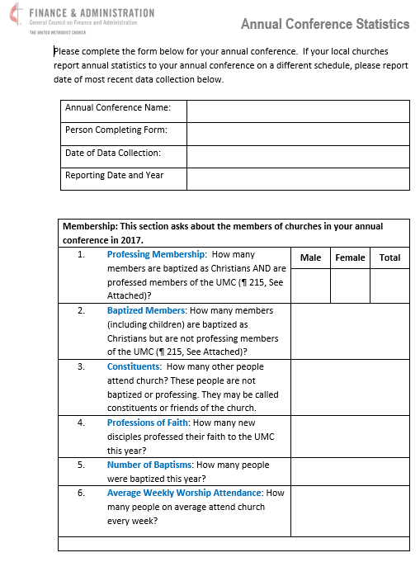
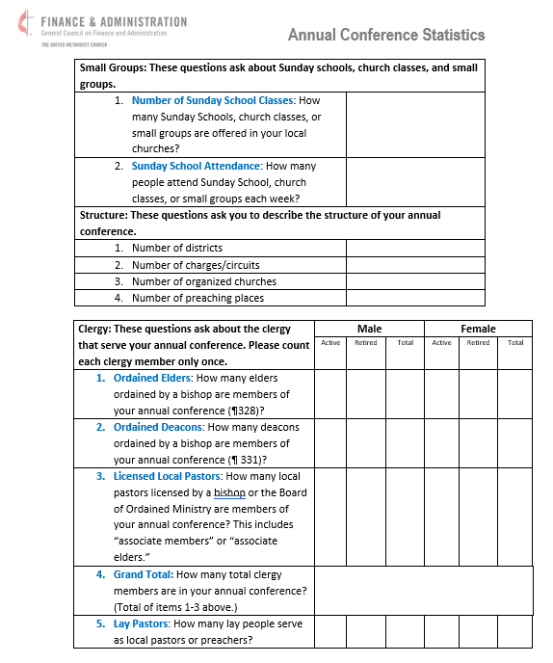
Annual Conference Statistics Form
z
ENG
Forms can be found in English, Korean, Spanish, Portuguese, French, and Kiswahili at https://www.gcfa.org/forms-and-assets
FRA
POR
Podem obter-se formulários em inglês, coreano, espanhol, português, francês e kiswahili em https://www.gcfaorg/forms-and-assets
SWA
Notes:
This is a copy of the Annual Conference Statistics form for Central Conferences. I know the information is small and I am not going to read through each entry. I wanted to show you what the form looks like.
All the forms that I discuss today are in the process of being translated into French, Swahili, and Portuguese. These forms will be sent out with the materials after today and also posted on the GCFA.org website.
Please be sure to fill out the form completely. When the Statistics form is placed in your journal, be sure to have the entire Conference Summary added. Historically, some central conferences have broken down the information by district, however, you also need to include the complete Conference summary.

Slide 9
Annual Conference Journal Submission
BOD Journal Requirements Information
ENG
The General Council on Finance and Administration (GCFA), on behalf of the Commission on General Conference (COGC), requests annual conference journals on a yearly basis.
FRA
Le Conseil général des finances et de l’administration (GCFA), au nom de la Commission de la Conférence générale (COGC), demande des journaux annuels de la conférence.
POR
O Conselho Geral de Finanças e Administração (CGFA), em nome da Comissão da Conferência Geral (CDCG), solicita, anualmente, os diários da conferência anual.
SWA
Baraza Kuu la Feza na Utawala (GCFA), kwa ruhusa ya Mkutano Mkuu (COGC), huomba majarida ya mkutano wa kila mwaka kila mwaka.
Notes:
The General Council on Finance and Administration (GCFA), on behalf of the Commission on General Conference (COGC), requests annual conference journals on a yearly basis.

Slide 10
Annual Conference Journal Submission
BOD Journal Requirements Information
ENG
The annual conference journal is comprised of the minutes taken during the annual conference’s yearly meeting
FRA
Le journal de la conférence annuelle est composé des procès-verbaux pris lors de la réunion annuelle de la conférence annuelle.
POR
O diário da conferência anual é composto pelas atas lavradas durante a reunião anual da conferência anual.
SWA
Gazeti la mkutano wa kila mwaka linajumuisha dakika zilizochukuliwa wakati wa mkutano wa kila mwaka wa mkutano wa kila mwaka
Notes:
The annual conference journal is comprised of the minutes taken during the annual conference’s yearly meeting

Slide 11
Annual Conference Journal Submission
BOD Journal Requirements Information
ENG
According to the Book of Discipline (BOD) ¶ 606.3:
“The annual conference may form a committee on journal publication. The annual conference journal shall include the following divisions, in the following order:
FRA
Selon le Livre de discipline (DB0) ¶ 606.3 :
« La conférence annuelle peut former un comité sur la publication des revues. Le journal annuel de la conférence comprend les sections ci-après, dans l’ordre suivant:
POR
Conforme o Livro da Disciplina ¶ 606.3:
“A conferência anual pode formar um comité de publicação de diários. O diário da conferência anual deve incluir as seguintes divisões, na seguinte ordem:
SWA
Kufwatana na Kitabu cha Kanuni (BOD) ¶ 606.3: "Mkutano wa kila mwaka unaweza kutunga kamati ya uchapishaji wa gazeti. Gazeti la mkutano wa kila mwaka inafai kuwa na mgawanyiko ufuatao, kwa utaratibu ufuatao:
Notes:
According to the Book of Discipline (BOD) ¶ 606.3:
“The annual conference may form a committee on journal publication. The annual conference journal shall include the following divisions, in the following order:

Slide 12
Annual Conference Journal Submission
BOD Journal Requirements Information
A.
ENG
Officers of annual conference
A.
FRA
Dirigeants de la conférence annuelle
A.
POR
Membros responsáveis da conferência anual
A.
SWA
Watangulizi wa mkutano wa kila mwaka
Notes:
Officers of annual conference

Slide 13
Annual Conference Journal Submission
BOD Journal Requirements Information
B.
ENG
Boards, commissions, committees; rolls of conference members,
B.
FRA
Conseils, commissions, comités; les listes des membres de la conférence,
B.
POR
Conselhos, comissões, comités; listas de membros da conferência
B.
SWA
Bodi, tume, kamati; Wajumbe wa mkutano,
Notes:
Boards, commissions, committees; rolls of conference members,

Slide 14
Annual Conference Journal Submission
BOD Journal Requirements Information
C.
ENG
Daily proceedings
C.
FRA
Délibérations quotidiennes
C.
POR
Procedimentos diários
C.
SWA
Maendeleo ya kila siku
Notes:
Daily proceedings

Slide 15
Annual Conference Journal Submission
BOD Journal Requirements Information
D.
ENG
Business of the annual conference report (formerly known as the disciplinary questions)
D.
FRA
Activité du rapport de la conférence annuelle (anciennement appelées questions disciplinaires)
D.
POR
Actividades do relatório da conferência anual (anteriormente denominadas questões disciplinares)
D.
Maneno ya ripoti ya mkutano wa kila mwaka (zamani inayojulikana kama maswali ya kanuni)
SWA
Notes:
Business of the annual conference report (formerly known as the disciplinary questions)

Slide 16
Annual Conference Journal Submission
BOD Journal Requirements Information
E.
ENG
Appointments
E.
FRA
Rendez-vous
E.
POR
Nomeações
E.
SWA
Madaraka
Notes:
Appointments

Slide 17
Annual Conference Journal Submission
BOD Journal Requirements Information
F.
ENG
Reports as ordered by the annual conference
F.
FRA
Rapports ordonnés par la conférence annuelle
F.
POR
Relatórios conforme ordenados pela conferência anual
F.
SWA
Repoti kama ilivyoagizwa na mkutano wa kila mwaka
Notes:
Reports as ordered by the annual conference

Slide 18
Annual Conference Journal Submission
BOD Journal Requirements Information
G.
ENG
Annual report of the district superintendents, if any
G.
FRA
Rapport annuel des surintendants de district, le cas échéant
G.
POR
Relatório anual dos superintendentes distritais, se houver
G.
SWA
Repoti ya mwaka ya mkuu wa distriki/wilaya
Notes:
Annual report of the district superintendents, if any

Slide 19
Annual Conference Journal Submission
BOD Journal Requirements Information
H.
ENG
Memoirs as ordered by the annual conference following the guidelines of the General Commission on Archives and History
H.
FRA
Mémoires commandés par la conférence annuelle suivant les directives du Commissariat général aux archives et à l’histoire
H.
POR
Memórias ordenadas pela conferência anual conforme as directrizes da Comissão Geral de Arquivos e História
H.
Kumbukumbu kama ilivyoagizwa na mkutano wa kila mwaka kufuatia miongozo ya Tume Kuu ya Kumbukumbu na Historia
SWA
Notes:
Memoirs as ordered by the annual conference following the guidelines of the General Commission on Archives and History

Slide 20
Annual Conference Journal Submission
BOD Journal Requirements Information
I.
ENG
Roll of dead-deceased clergy members
I.
FRA
Liste des membres du clergé décédés et décédés
I.
POR
Lista de membros do clero falecidos
I.
SWA
Majina ya wapastori waliofariki
Notes:
Roll of dead-deceased clergy members

Slide 21
Annual Conference Journal Submission
BOD Journal Requirements Information
J.
ENG
Historical
J.
FRA
Historique
J.
POR
Histórico
J.
SWA
Kihistoria
Notes:
Historical

Slide 22
Annual Conference Journal Submission
BOD Journal Requirements Information
K.
ENG
Miscellaneous
K.
FRA
Divers
K.
POR
Diversos
K.
SWA
Tofauti ya/ Vigine
Notes:
Miscellaneous

Slide 23
Annual Conference Journal Submission
BOD Journal Requirements Information
L.
ENG
Pastoral record (including the records of accepted local pastors in such manner as the conference may determine)
L.
Registre pastoral (y compris les registres des pasteurs locaux acceptés de la manière déterminée par la conférence)
FRA
L.
Registo pastoral (incluindo os registos de pastores locais aceites conforme a conferência determinar)
POR
L.
Rekodi ya wachungaji (ikiwa ni pamoja na kumbukumbu za wachungaji wa mahali hapo waliokubaliwa kwa njia kama vile mkutano unaweza kuamua)
SWA
Notes:
Pastoral record (including the records of accepted local pastors in such manner as the conference may determine)

Slide 24
Annual Conference Journal Submission
BOD Journal Requirements Information
M.
ENG
Statistics
M.
FRA
Statistiques
M.
POR
Dados estatísticos
M.
SWA
Takwimu/wingi
Notes:
Statistics

Slide 25
Annual Conference Journal Submission
BOD Journal Requirements Information
N.
ENG
Index
N.
FRA
Index
N.
POR
Índice
N.
SWA
Kielezo
Notes:
Index

Slide 26
Annual Conference Journal Submission
BOD Journal Requirements Information
ENG
Examples of Conference Journals can be provided upon request.
FRA
Des exemples de journaux de conférence peuvent être fournis sur demande.
POR
Exemplos de Diários de Conferências podem ser fornecidos mediante pedido
SWA
Mifano ya Gazeti za Mkutano zinaweza kutolewa kwa ombi
Notes:
Examples of Conference Journals can be provided upon request.

Slide 27
Annual Conference Journal Submission
BOD Journal Requirements Information
ENG
The Journal should be completed soon after the annual conference meeting and then sent to specific general agencies as described in the BOD, ¶ 606.2:
FRA
Le Journal devrait être terminé peu après la réunion de la conférence annuelle, puis envoyé à des organismes généraux spécifiques, comme décrit dans le Livre de Discipline ¶606.2:
POR
O Diário deve ser completado logo após a reunião da conferência anual e, em seguida, enviado para agências gerais específicas, conforme descrito no Livro da Disciplina, ¶ 606.2
SWA
Gazeti linapaswa kukamilika mara tu baada ya mkutano wa kila mwaka na kisha kutumwa kwa baraza kama ilivyoelezwa katika BOD, ¶ 606.2:
Notes:
The Journal should be completed soon after the annual conference meeting and then sent to specific general agencies as described in the BOD, ¶ 606.2:

Slide 28
Annual Conference Journal Submission
BOD Journal Requirements Information
“Each annual conference shall send without charge to the General Council on Finance and Administration, the General Board of Pension and Health Benefits, the General Commission on Archives and History, the Central Conference or Jurisdictional Commission on Archives and History, and the Annual Conference Commission on Archives and History two printed copies or a digital version of its annual journal. In addition, the annual conference shall send one printed copy or a digital version of its annual journal to the Connectional Table and one printed copy or a digital version to United Methodist Communications. If available, one copy of a digital version of the journal shall be sent to the General Commission on Archives and History and one copy to United Methodist Communications.”
ENG
FRA
« Chaque conférence annuelle envoie gratuitement au Conseil général des finances et de l’administration, au Conseil général des pensions et des prestations de santé, au Commissariat général aux archives et à l’histoire, à la Conférence centrale ou à la Commission juridictionnelle des archives et de l’histoire et à la Commission des archives et de l’histoire de la Conférence annuelle deux exemplaires imprimés ou une version numérique de son journal annuel. En outre, la conférence annuelle enverra une copie imprimée ou une version numérique de son journal annuel à la Table de connexion et une copie imprimée ou une version numérique à Communications Méthodistes Unies. Si disponible, un exemplaire d’une version numérique de la revue sera envoyé au Commissariat général aux archives et à l’histoire et un exemplaire à Communications Méthodistes Unies.
POR
“Cada conferência anual enviará gratuitamente para o Conselho Geral de Finanças e Administração, a Junta Geral de Pensões e Benefícios de Saúde, a Comissão Geral de Arquivos e História, a Conferência Central ou a Comissão Jurisdicional de Arquivos e História e a Comissão de Arquivos e História da Conferência Anual duas cópias impressas ou uma versão digital do seu diário anual. Além disso, a conferência anual enviará uma cópia impressa ou uma versão digital de seu diário anual para a Mesa Conexional e uma cópia impressa ou uma versão digital para as Comunicações Metodistas Unidas. Se disponível, uma cópia de uma versão digital do diário deve ser enviada para a Comissão Geral de Arquivos e História e uma cópia para as Comunicações Metodistas Unidas”.
SWA
"Kila mkutano wa kila mwaka utatuma bila malipo kwa Baraza Kuu la Fedha na Utawala, Baraza Kuu ya Pensheni na Faida za Afya, Tume Kuu ya Kumbukumbu na Historia, Mkutano Mkuu au Tume ya Mahakama ya Kumbukumbu na Historia, na Tume ya Mkutano wa Mwaka juu ya Kumbukumbu na Historia nakala mbili zilizochapishwa au toleo la dijiti la jarida lake la kila mwaka. Kwa kuongezea, mkutano wa kila mwaka utatuma nakala moja iliyochapishwa au toleo la dijiti la jarida lake la kila mwaka kwa Jedwali la Muunganisho na nakala moja iliyochapishwa au toleo la dijiti kwa Mawasiliano ya United Methodist. Ikiwa inapatikana, nakala moja ya toleo la dijiti la jarida itatumwa kwa Tume Kuu ya Kumbukumbu na Historia na nakala moja kwa Mawasiliano ya Methodist ya Umoja."
Notes:
This paragraph outlines the agencies that are to receive the Annual Conference Journal. GCFA is to receive two printed copies or one digital copy.

Slide 29
Annual Conference Journal Submission
BOD Journal Requirements Information
ENG
In order to simplify this process, a digital copy of the journal may be uploaded to a Dropbox area. The link is provided by GCFA and the Data Services team. It will then be distributed to all the appropriate general agencies
FRA
Afin de simplifier ce processus, une copie numérique du journal peut être téléchargée sur Dropbox. Le lien est fourni par GCFA et l’équipe des services des données. GCFA est chargé ensuite de distribué à toutes les agences générales appropriées.
POR
Para simplificar este processo, uma cópia digital do diário pode ser telecarregada numa área da Dropbox. O link é fornecido pelo CGFA e pela equipa de Serviços de Dados. Em seguida, será distribuído por todas as agências gerais apropriadas.
SWA
Ili kurahisisha mchakato huu, nakala ya dijiti ya jarida inaweza kupakiwa kwenye eneo la Dropbox. Kiungo kinatolewa na GCFA na timu ya Huduma za Takwimu. Kisha itasambazwa kwa mashirika yote ya jumla yanayofaa
Notes:
In order to simplify this process, a digital copy of the journal may be uploaded to a Dropbox area. The link is provided by GCFA and the Data Services team. It will then be distributed to all the appropriate general agencies

Slide 30
Annual Conference Journal Submission
BOD Journal Requirements Information
ENG
Any hard copies may be sent through the mail to:
GCFA
ATTN: Data Services Department
1908 Grand Ave
Nashville, TN 37203
FRA
Toute copie papier peut être envoyée par la poste à l’adresse suivante :
GCFA
À l’attention de : Département des services de données
1908, avenue Grand
Nashville, TN 37203
POR
Quaisquer cópias impressas podem ser enviadas pelo correio para:
GCFA
ATTN: Data Services Department
1908 Grand Ave
Nashville, TN 37203
SWA
Nakala ngumu zozote zaweza kutumwa kibarua kwa
GCFA
ATTN: Data Services Department
1908 Grand Ave
Nashville, TN 37203
Notes:
Any hard copies may be sent through the mail to the address listed. Please note that this is a new address and make sure your records are updated accordingly.

Slide 31
Annual Conference Journal Submission
BOD Journal Requirements Information
ENG
The Commission on General Conference uses the statistical reports in the annual conference journals to determine the number of delegates for General Conference. This is described in BOD ¶ 511.5:
FRA
La Commission de la Conférence générale utilise les rapports statistiques des journaux annuels de la Conférence pour déterminer le nombre de délégués à la Conférence générale. Ceci est décrit dans ¶ 511.5 du Livre de Discipline:
POR
A Comissão da Conferência Geral usa os relatórios de dados estatísticos nos diários da conferência anual para determinar o número de delegados para a Conferência Geral. Isto está descrito no Livro da Disciplina (LDD) no ¶ 511.5
SWA
Tume la Konfarasa ya kijumla utumia riporti za takwimu katika jarida la mkutano wa kila mwaka hili kuamua namabri ya wajumbe wa Konfarasa ya kijumla. Hii imeelezwa katika kitabu cha nidhamu BOD ¶ 511.5:
Notes:
One of the many uses of your Annual Conference Journal is The Commission on General Conference uses the statistical reports in the annual conference journals to determine the number of delegates for General Conference.
This is described in BOD ¶ 511.5 which states:

Slide 32
Annual Conference Journal Submission
BOD Journal Requirements Information
“The secretary of the General Conference shall calculate the number of delegates to be elected by each annual conference, based on the factors specified in ¶ 502.1, 2, using the most recent clergy and professing lay membership figures reported by the local congregation to the annual conference and from the annual conference to the General Council on Finance and Administration through their conference journals, as follows:
ENG
FRA
“Le secrétaire de la Conférence générale calcule le nombre de délégués à élire par chaque conférence annuelle, en fonction des facteurs précisés aux numéros 502.1, 2, en utilisant les chiffres les plus récents du clergé et des professant laïcs déclarés par la congrégation locale à la conférence annuelle et de la conférence annuelle au Conseil général des finances et de l’administration par l’intermédiaire de leurs journaux de conférence, comme suit:
“O secretário da Conferência Geral deve calcular o número de delegados a eleger por cada conferência anual, com base nos factores especificados no ¶ 502.1, 2, usando os números mais recentes de membros do clero e membros leigos professos comunicados pela congregação local à conferência anual e da conferência anual ao Conselho Geral de Finanças e Administração através dos seus diários de conferência, tal como se segue:
POR
Katibu wa mkutano wa kijumla atahesabu nambari ya wajumbe watakaochaguliwa na kila konfarasa ya kimwaka, kulingana na sababu maalum zilizo katika ¶ 502.1, 2, wakitumia namabari za ushirika za hivi karibuni zilizoripotiwa na kanisa la mtaa kwa mkutano wa kimwaka na kutoka kwa mkutano wa mwak kwenedela kwa baraza la kuu la Fedha na utawala.
SWA
Notes:
“The secretary of the General Conference shall calculate the number of delegates to be elected by each annual conference, based on the factors specified in ¶ 502.1, 2, using the most recent clergy and professing lay membership figures reported by the local congregation to the annual conference and from the annual conference to the General Council on Finance and Administration through their conference journals, as follows:

Slide 33
Annual Conference Journal Submission
BOD Journal Requirements Information
A.
ENG
One clergy delegate for the first 375 clergy members of the annual conference and one clergy delegate for each additional 375 clergy members or major fraction thereof, and
A.
FRA
un délégué du clergé pour les 375 premiers membres du clergé de la conférence annuelle et un délégué du clergé pour chaque tranche supplémentaire de 375 membres du clergé ou fraction majeure de ceux-ci, et
A.
POR
Um delegado do clero para os primeiros 375 membros do clero da conferência anual e um delegado do clero para cada 375 membros adicionais do clero ou fracção maior, e
A.
SWA
Mjumbe mmoja wa makasisi kwa washiriki wa kwanza wa makasisi 375 wa mkutano wa kila mwaka na mjumbe mmoja wa makasisi kwa kila washiriki wa ziada wa makasisi 375 au sehemu yake kuu, na
Notes:
One clergy delegate for the first 375 clergy members of the annual conference and one clergy delegate for each additional 375 clergy members or major fraction thereof, and

Slide 34
Annual Conference Journal Submission
BOD Journal Requirements Information
B.
One clergy delegate for the first 26,000 members of local churches of the annual conference and one clergy delegate for each additional 26,000 local church members or major fraction thereof, and
ENG
Un délégué du clergé pour les 26 000 premiers membres des églises locales de la conférence annuelle et un délégué du clergé pour chaque tranche supplémentaire de 26 000 membres d’église locale ou fraction majeure de ceux-ci, et
B.
FRA
B.
POR
Um delegado do clero para os primeiros 26.000 membros das igrejas locais da conferência anual e um delegado do clero para cada 26.000 membros adicionais da igreja local ou fracção maior, e
B.
SWA
Mjumbe mmoja wa kasisi kwa washiriki 26,000 wa kwanza wa makanisa ya mtaa wa konferensi ya kila mwaka na mjumbe mmoja wa kasisi kwa kila washiriki 26,000 wa ziada wa kanisa la mtaa au sehemu yake kuu, na
Notes:
One clergy delegate for the first 26,000 members of local churches of the annual conference and one clergy delegate for each additional 26,000 local church members or major fraction thereof, and

Slide 35
Annual Conference Journal Submission
BOD Journal Requirements Information
C.
A number of lay delegates equal to the total number of clergy delegates authorized as above
ENG
Un nombre de délégués laïcs égal au nombre total de délégués du clergé autorisés comme ci-dessus.
C.
FRA
C.
POR
Um número de delegados leigos igual ao número total de delegados do clero autorizados conforme acima
C.
SWA
Idadi ya wajumbe walei sawa na jumla ya idadi ya wajumbe wa makasisi walioidhinishwa kama ilivyo hapo juu.
Notes:
A number of lay delegates equal to the total number of clergy delegates authorized as above

Slide 36
Annual Conference Journal Submission
BOD Journal Requirements Information
D.
D.
ENG
Every annual conference shall be entitled to at least one clergy and one lay delegate
D.
FRA
Chaque conférence annuelle a droit à au moins un membre du clergé et un délégué laïc.
D.
POR
Cada conferência anual terá direito a pelo menos um membro do clero e um delegado leigo
D.
SWA
Kila mkutano wa kimwaka litastahiki angalau kasisi mmoja na mjumbe mlei mmoja.

Slide 37
Annual Conference Journal Submission
BOD Journal Requirements Information
E.
This formula is designated to comply with the Constitution, Division Two, Section II, Article I (¶ 13), which defines the minimum and maximum number of delegates to a General Conference. Should the computations provided in the paragraph result in a figure below the prescribed minimum or above the prescribed maximum for delegates, the Commission on the General Conference shall be authorized to remedy the situation by adjusting up or down the numbers of clergy members and members of local churches of the annual conference necessary to entitle an annual conference to elect delegates, any such adjustment to be proportionally the same for the two factors.”
ENG
E.
Cette formule est conçue pour se conformer à l’article I (¶ 13) de la section II, section II, de la Constitution, qui définit le nombre minimum et maximum de délégués à une conférence générale. Si les calculs prévus au paragraphe aboutissent à un chiffre inférieur au minimum prescrit ou supérieur au maximum prescrit pour les délégués, la Commission de la Conférence générale est autorisée à remédier à la situation en ajustant à la hausse ou à la baisse le nombre des membres du clergé et des membres des Églises locales de la Conférence annuelle nécessaire pour donner à une conférence annuelle le droit d’élire des délégués, cet ajustement devant être proportionnellement le même pour les deux facteurs.
FRA
E.
Esta fórmula é designada para cumprir a Constituição, Divisão Dois, Seção II, Artigo I ( ¶ 13), que define o número mínimo e máximo de delegados para uma Conferência Geral. Se os cálculos fornecidos no parágrafo resultarem em um número abaixo do mínimo prescrito ou acima do máximo prescrito para delegados, a Comissão da Conferência Geral será autorizada a remediar a situação ajustando para cima ou para baixo o número de membros do clero e membros das igrejas locais da conferência anual necessário para autorizar uma conferência anual a eleger delegados. Qualquer ajuste desse tipo deve ser proporcionalmente o mesmo para os dois factores.
POR
E.
Fomula hii imeteuliwa kuambatana na Katiba, Kitengo cha Pili, Kifungu cha II, Kifungu cha I ( ¶ 13), ambacho kinafafanua idadi ya chini na ya juu zaidi ya wajumbe wa Mkutano Mkuu. Endapo hesabu zilizotolewa katika aya zitasababisha kielelezo chini ya kiwango cha chini kilichowekwa au zaidi ya kiwango kilichowekwa kwa wajumbe, Tume ya Konferensi Kuu itaidhinishwa kurekebisha hali hiyo kwa kurekebisha au kupunguza idadi ya makasisi na washiriki wa makanisa ya kila mwaka ya konferensi ya kila mwaka inayohitajika ili kutoa haki kwa konferensi ya kila mwaka ya kuwachagua wajumbe, marekebisho yoyote kama hayo yawe sawa kwa uwiano wa vipengele viwili.”
SWA
Notes:
This formula defines the minimum and maximum number of delegates to a General Conference.
If the total number of delegates falls outside the parameters for minimum and maximum delegate counts, the Commission on the General Conference will make adjustments accordingly.

Slide 38
Annual Conference Journal Submission
BOD Journal Requirements Information
ENG
NOTE
The most recent clergy and professing lay membership figures come from your Journal which is why it is so vital to include your Statistics form in the Journal to allow delegate calculations to be up to date
FRA
NOTE
Les chiffres les plus récents du clergé et des laïcs proviennent de votre Journal, c’est pourquoi il est si important d’inclure votre formulaire de statistiques dans le Journal pour permettre aux calculs des délégués d’être à jour.
POR
NOTA
Os números mais recentes de membros do clero e membros leigos professos vêm do seu Diário e, é por isso que é essencial incluir o seu formulário de Dados Estatísticos no Diário para permitir que os cálculos dos delegados estejam actualizados.
SWA
NOTE
Idadi ya hivi majuzi ya makasisi na walei wanaodai kuwa wanachama hutoka katika Jarida lako ndiyo maana ni muhimu sana kujumuisha fomu yako ya Takwimu kwenye Jarida ili kuruhusu hesabu za wajumbe kusasishwa.
Notes:
The most recent clergy and professing lay membership figures come from your Journal which is why it is so vital to include your Conference Statistics form in the Journal to allow delegate calculations to be up to date.
If your Annual Conference Journal does not have your statistical form within it, we will look at prior year journals until we find the statistical form.

Slide 39
Annual Conference Journal Submission
BOD Journal Requirements Information
ENG
GCFA uses the professing membership statistics reports in the annual conference journals to determine the apportionments for each one
FRA
GCFA utilise les rapports statistiques des membres professant dans les journaux de la conférence annuelle pour déterminer les contributions de chaque conférence.
POR
O CGFA usa os relatórios estatísticos dos membros professos nos diários da conferência anual para determinar as contribuições para cada um
SWA
GCFA hutumia ripoti za takwimu za wanachama wanaodai katika majarida ya mkutano wa kila mwaka ili kubainisha mgao wa kila moja.
Notes:
GCFA uses the professing membership statistics reports in the annual conference journals to determine the apportionments for each conference

Slide 40
Annual Conference Journal Submission
BOD Journal Requirements Information
ENG
The apportionment formula is discussed in detail in Report 8 of the Financial Commitment Book and also presented in the Finance section of the materials
FRA
La formule de répartition est examinée en détail dans le rapport 8 du Livre d’engagements financiers et également présentée dans la section Finances des documents.
POR
A fórmula da contribuição é discutida em pormenor no Relatório 8 do Livro de Compromissos Financeiros e também é apresentada na secção de Finanças dos materiais
SWA
Fomula ya ugawaji imejadiliwa kwa kina katika Ripoti ya 8 ya Kitabu cha Ahadi za Kifedha na pia kuwasilishwa katika sehemu ya Fedha ya nyenzo.
Notes:
The apportionment formula is discussed in detail in Report 8 of the Financial Commitment Book and also presented in the Finance section of the materials

Slide 41
Leadership Form
Conference Leadership form
ENG
The Conference Leadership form is to be filled out quarterly and sent to GCFA so your Leadership staff can be updated in our records
FRA
Le formulaire des Responsables de la conférence doit être rempli tous les trimestres et envoyé au GCFA afin que votre liste des responsables courante puisse être mis à jour dans notre base de données.
POR
O formulário para Lideres da Conferência deve ser preenchido trimestralmente e enviado para o GCFA para que os seus responsáveis pela liderança possam ser actualizados nos nossos registos
SWA
Fomu ya Uongozi wa Konfarasa inapaswa kujazwa kila baada ya miezi mitatu na kutumwa kwa GCFA ili wafanyakazi wako wa Uongozi wasasishwe katika rekodi zetu.
Notes:
The Conference Leadership form is to be filled out quarterly and sent to GCFA so your Leadership staff can be updated in our records

Slide 42
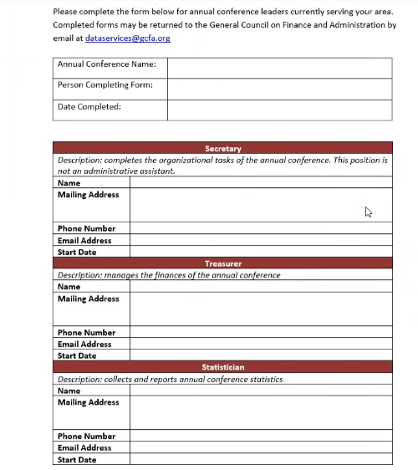
Leadership Form
Conference Leadership form
z
ENG
FRA
POR
SWA
Notes:
This is page one of the Annual Conference Leadership form for conferences. We have updated this form so please be sure you are using the latest version.
As a reminder, all the forms that I discuss today are in the process of being translated into French, Swahili, and Portuguese and will be sent out with the materials after today and also posted on the GCFA.org website.

Slide 43
Additional Information
ENG
Reminders:
Deaconesses are considered LAY and not CLERGY
Home Missioners are considered LAY and not CLERGY
Enter your Clergy count in the journal within the BAC
FRA
Rappels:
Les diacres sont considérés comme des laïcs et non des membres du clergé
Les Missionaires internes sont considérés comme des laïcs et non des membres du clergé
Entrez votre nombre de membres du clergé dans le journal (document de travail de la conférence annuelle)
POR
Lembretes:
Os diáconos e as diaconisas são considerados LEIGOS e não CLERO
Os Missionários Nacionais são considerados LEIGOS e não CLERO
Insira a sua contagem do Clero no diário no BAC
SWA
Vikumbusho:
Shemasi/ Mashemashi wanachukuliwa kuwa WALEI na sio MKADHA
Wamisionari wa Nyumbani wanachukuliwa kuwa WALEI na sio MKADHA
Ingiza idadi yako ya Makasisi kwenye jarida ndani ya BAC
Notes:
When you are filling out your Statistics and BAC, please keep these items in mind:
Deaconess are considered LAY and not CLERGY
Home Missioners are considered LAY and not CLERGY
Enter your Clergy count in the journal within the BAC

Slide 44
Additional Information
ENG
Changes:
GCFA will be updating the BAC after General Conference (May 2024)
FRA
Changements:
Après la Conférence générale (mai 2024) GCFA va actualiser l’ordre des travaux de la conférence annuelle.
POR
Mudanças:
O CGFA actualizará o BAC após a Conferência Geral (maio de 2024)
SWA
Mabadiliko:
GCFA itakuwa ikisasisha BAC baada ya Mkutano Mkuu (Mei 2024)
Notes:
GCFA will be updating the BAC after General Conference (May 2024)

Slide 45
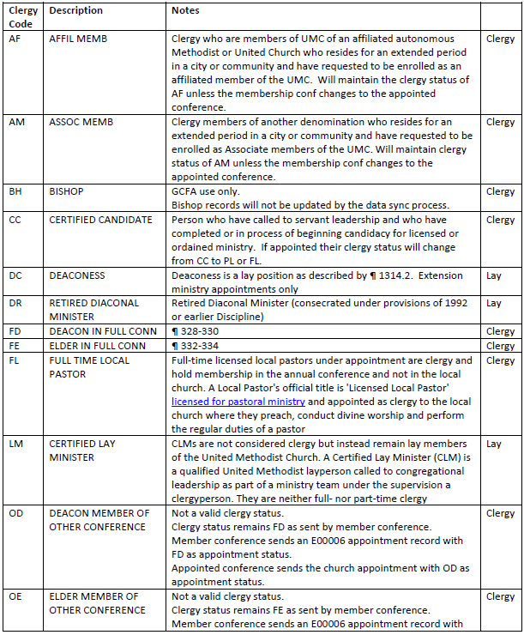
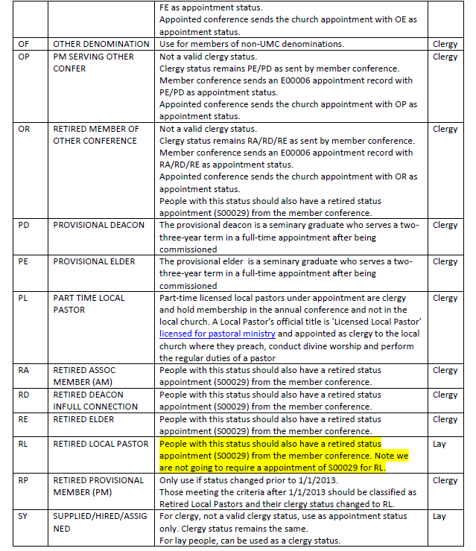
Clergy/Church Breakdown
Clergy Codes and Descriptions
z
ENG
FRA
POR
SWA
Notes:
The following slides will show some pictures of our Clergy Codes and Descriptions document and also define the various Church Types.
As a reminder, we will provide this information to you.

Slide 46
Church Definitions
ENG
Definitions of Church Types
Chartered: Une église locale affiliée est une congrégation autonome et pleinement opérationnelle dont un pasteur y est affecté et qui doit présenter un rapport financier et participatif annuel à sa conférence annuelle. L’organisation de l’église locale est définie dans le Livre de Discipline au ¶ 244. Une église affiliée n’a pas le statut de « nouvelle église débutante», elle n’est ni une église de mission ou rattachée à une autre congrégation, à moins d’être satellite à une communauté mère.
FRA
Définitions des types d’église
Affiliées: Une église locale affiliée est une congrégation autonome et pleinement opérationnelle dont un pasteur y est affecté et qui doit présenter un rapport financier et participatif annuel à sa conférence annuelle. L’organisation de l’église locale est définie dans le Livre de Discipline au ¶ 244. Une église affiliée n’a pas le statut de « nouvelle église débutante», elle n’est ni une église de mission ou rattachée à une autre congrégation, à moins d’être satellite à une communauté mère.
POR
Definições de tipos de Igreja
Oficial: Uma igreja local oficial é uma congregação independente e totalmente operacional para a qual foi nomeado um pastor. Espera-se que forneça um relatório financeiro e participativo anual à sua conferência anual. A organização da igreja local está definida no Livro de Disciplina ¶ 244. Uma igreja oficial não tem o estado de “Igreja Nova”, nem é uma igreja de missão ou anexada a outra congregação, a menos que seja a matriz de uma igreja satélite.
SWA
Ufafanuzi wa Aina za Kanisa
Imeidhinishwa: Kanisa la mtaa lililokodishwa ni kutaniko lililo huru, linalofanya kazi kikamilifu, ambalo limeteuliwa kuwa mchungaji, na linatarajiwa kutoa ripoti ya kila mwaka ya fedha na shirikishi kwa kongamano lake la kila mwaka. Mpangilio wa kanisa la mtaa umefafanuliwa katika BOD ¶ 244. Kanisa lililokodishwa haliko katika hadhi ya "Kuanza Kanisa Jipya", wala si kanisa la misheni au kuunganishwa na kutaniko lingine, isipokuwa kama mzazi kwa satelaiti.
Notes:
There are four church types that are defined:
Chartered
New Church Start
Satellite and
Mission
We also recognize central conferences have
Preaching Places
Fresh Expressions
We will provide definitions for these at a later date.
A chartered local church is a freestanding, fully operational, congregation that has been appointed a pastor, and is expected to give an annual financial and participatory report to its annual conference. A chartered church is not in “New Church Start” status, nor is it a mission church or attached to another congregation, unless as the parent to a satellite.

Slide 47
Church Definitions
Definitions of Church Types
New Church Start: A New Church Start is a church that has been established with the consent of the Bishop, but has not yet reached a level of organization to garner it a “chartered” church. A New Church Start may be appointed a pastor or submit statistics, but it is considered new (and given considerations associated with any newcomer) until the conference authorizes its charter. More information can be found in the BOD ¶ 259.2.
ENG
Définitions des types d’église
Nouvelle Église Débutantee: Une nouvelle église débutante est une église qui a été établie avec le consentement de l’évêque, mais qui n’a pas encore atteint un niveau d’organisation requise pour être une église « affiliée ». Un pasteur peut être affecté dans une nouvelle église débutante, elle peut soumettre des statistiques, mais elle est considérée comme nouvelle (et compte tenu des considérations associées à tout nouveau venu) jusqu’à ce que la conférence autorise son affiliation. Vous trouverez plus d’informations dans le BOD ¶ 259.2.
FRA
POR
Definições de tipos de Igreja
Igreja nova: Uma Igreja Nova é uma igreja que foi estabelecida com o consentimento do Bispo, mas ainda não atingiu um nível de organização para ser uma igreja “oficial”. Uma Igreja Nova pode ter um pastor nomeado ou enviar dados estatísticos, mas é considerada nova (e recebe considerações associadas a qualquer recém-chegado) até que a conferência autorize a sua oficialização. No Livro da Disciplina ¶ 259.2 podem encontrar=se mais informações.
SWA
Kuanzishwa kwa kanisa mpya: Anzisho Jipya la Kanisa ni kanisa ambalo limeanzishwa kwa idhini ya Askofu, lakini bado halijafikia kiwango cha shirika ili kulitengenezea kanisa "lililoidhinishwa". Anzisho Jipya la Kanisa linaweza kuteuliwa mchungaji au kuwasilisha takwimu, lakini linachukuliwa kuwa jipya (na kuzingatia mambo yanayohusiana na mgeni yeyote) hadi mkutano uidhinishe katiba yake. Habari zaidi inaweza kupatikana katika BOD ¶ 259.2.
Notes:
A New Church Start is a church that has been established with the consent of the Bishop, but has not yet reached a level of organization to garner it a “chartered” church. A New Church Start may be appointed a pastor or submit statistics, but it is considered new (and given considerations associated with any newcomer) until the conference authorizes its charter.

Slide 48
Church Definitions
Definitions of Church Types
Satellite: When authorized by the district superintendent and the district board of church location and building, chartered local churches may sponsor or serve as “parent” to a satellite church. The satellite is often a separate site or campus of a larger local church congregation.
ENG
Définitions des types d’église
Satellite: Lorsqu’elles sont autorisées par le surintendant de district et le conseil de district de l’emplacement et de la construction de l’église, les églises locales affiliées peuvent parrainer ou servir de « parent » à une église satellite. L’église satellite est souvent un site ou un campus séparé d’une plus grande congrégation ecclésiastique locale.
FRA
Definições de tipos de Igreja
Satélite: Quando autorizado pelo superintendente distrital e pela junta distrital de localização e construção da igreja, as igrejas locais oficiais podem patrocinar ou servir como “matriz” de uma igreja satélite. A igreja satélite geralmente é um local ou campus separado de uma congregação maior da igreja local.
POR
SWA
Sataleti: Yakiidhinishwa na msimamizi wa wilaya na halmashauri ya wilaya ya eneo na jengo la kanisa, makanisa ya mtaa yaliyokodishwa yanaweza kufadhili au kutumika kama "mzazi" kwa kanisa la satelaiti. Satelaiti mara nyingi ni tovuti tofauti au kampasi ya kutaniko kubwa la kanisa la mtaa.
Notes:
When authorized by the district superintendent and the district board of church location and building, chartered local churches may sponsor or serve as “parent” to a satellite church. The satellite is often a separate site or campus of a larger local church congregation.

Slide 49
Church Definitions
ENG
Definitions of Church Types
Mission: Congregations are designated as “Missions” when membership opportunities and resources place limits on the church’s abilities to obtain charter status. These churches often are created strategically in order to serve a limited population such as those of a minority demographic or to cater to other cultures or languages. Missions are often funded by sources outside of the congregation and rarely support the UMC connection through apportionments or other income, and the annual conference usually provides long-term administrative guidance of the congregation. The mission congregation may be organized in the same manner of any local church and can have the same rights and powers, as such submitting statistics to GCFA, as decided by the annual conference. The BOD ¶ 259.1a provides further detail.
FRA
Définitions des types d’église
Mission: Les congrégations sont désignées comme « missions » lorsque les possibilités d’adhésion et les ressources limitent les capacités de l’église à obtenir le statut d’affiliée. Ces églises sont souvent créées stratégiquement afin de servir une population limitée telle que celles d’une minorité démographique ou de répondre aux besoins d’autres cultures ou langues. Les missions sont souvent financées par des sources extérieures à la congrégation et soutiennent rarement la connexion de l’EMU par le biais de contributions ou d’autres revenus, et la conférence annuelle fournit généralement une orientation administrative à long terme de la congrégation. La congrégation missionnaire peut être organisée de la même manière que n’importe quelle église locale et peut avoir les mêmes droits et pouvoirs, en tant que telle en soumettant des statistiques à la GCFA, comme décidé par la conférence annuelle. Le BOD ¶ 259.1a fournit plus de détails. detail.
POR
Definições de tipos de Igreja
Missão: As congregações são designadas como “Missões” quando as oportunidades e recursos de membresia colocam limites na capacidade da igreja para obter o estado de oficial. Estas igrejas geralmente são criadas estrategicamente para servir uma população limitada, como as de uma minoria demográfica ou para atender a outras culturas ou idiomas. As missões são frequentemente financiadas por fontes independentes da congregação e raramente apoiam a conexão da IMU através de contribuições ou outras receitas, e a conferência anual geralmente fornece orientação administrativa a longo prazo para a congregação. A congregação da missão pode ser organizada da mesma forma que qualquer igreja local e pode ter os mesmos direitos e poderes, como tal, apresentar estatísticas ao CGFA, conforme decidido pela conferência anual. O Livro da Disciplina ¶ 259.1a fornece mais pormenores.
Ufafanuzi wa Aina za Kanisa
Misheni: Makutaniko yameteuliwa kama “Misheni” wakati fursa za uanachama na rasilimali zinaweka mipaka kwenye uwezo wa kanisa kupata hadhi ya mkataba. Makanisa haya mara nyingi huundwa kimkakati ili kuhudumia idadi ndogo ya watu kama vile wale wa idadi ndogo ya watu au kuhudumia tamaduni au lugha zingine. Misheni mara nyingi hufadhiliwa na vyanzo vya nje ya kutaniko na mara chache haitumii muunganisho wa UMC kupitia mgao au mapato mengine, na mkutano wa kila mwaka kwa kawaida hutoa mwongozo wa utawala wa muda mrefu wa kutaniko. Kutaniko la misheni linaweza kupangwa kwa njia sawa na kanisa lolote la mtaa na linaweza kuwa na haki na mamlaka sawa, kama vile kuwasilisha takwimu kwa GCFA, kama ilivyoamuliwa na kongamano la kila mwaka. BOD ¶ 259.1a inatoa maelezo zaidi.
SWA
Notes:
Congregations are designated as “Missions” when membership opportunities and resources place limits on the church’s abilities to obtain charter status. These churches often are created strategically in order to serve a limited population such as those of a minority demographic or to cater to other cultures or languages. Missions are often funded by sources outside of the congregation and rarely support the UMC connection through apportionments or other income, and the annual conference usually provides long-term administrative guidance of the congregation. The mission congregation may be organized in the same manner of any local church and can have the same rights and powers, as such submitting statistics to GCFA, as decided by the annual conference.

