Slide 1

GCFA UPDATE
NAACT 2024

Slide 2
Boy Scouts of America Bankruptcy
UPDATE

Slide 3
BSA Bankruptcy Update
TIMELINE
September 8, 2022
February 18, 2020
December 21, 2021
March 27, 2023
Bankruptcy Court approves reorganization plan (“Third Modified Fifth Amended Plan of Reorganization”)
17 parties filed appeals
(15 “non-settling” insurers and 2 victim groups)
Bankruptcy petition filed
United Methodist Term Sheet filed
District Court affirms Bankruptcy Court’s confirmation of the plan

Slide 4
BSA Bankruptcy Update
TIMELINE
April 19, 2023
August 10, 2023
October 2023
June 27, 2024
Initial $2 million deposit placed into escrow
(due 180 days after effective date)
U.S. Supreme Court overturns Purdue Pharma bankruptcy plan
Held: non-consensual releases of third-party non-debtors are not permitted under the
Bankruptcy Code
Third Circuit denies appellants request for a stay pending further appeal,
so plan goes effective
15 parties appealed to the Third Circuit, briefing is ongoing
U.S. Supreme Court grants review in the Purdue Pharma bankruptcy, calling into question validity of third-party releases in bankruptcy

Slide 5
BSA Bankruptcy Update
NOW WHAT?
Supreme Court also said: “we do not address whether our reading of the bankruptcy code would justify unwinding reorganization plans that have already become effective and been substantially consummated”
?
3rd Circuit asked for briefing on the impact of the Purdue Pharma decision on the pending BSA appeal
GCUMM joined an amicus brief addressing concerns of chartered organizations
Oral argument was not scheduled pending the Purdue Pharma ruling, now expected in October 2024
Whatever the 3rd Circuit rules, it will be appealed to the Supreme Court
If review is granted, there may not be a final determination until 2026

Slide 6
QUESTION
AND ANSWER
SESSION

Slide 7
LITIGATION
UPDATE

Slide 8
Litigation Update
We are aware of active/recent litigation in 14 states:
Alabama
Arkansas
California
Connecticut
Florida
Georgia
Hawaii
Indiana
Maryland
New Jersey
North Carolina
Oklahoma
Tennessee
Texas

Slide 9
Litigation Update
These Cases:
Are filed by 1 church, a few dozen churches, 100+ churches
Are filed by the National Center for Life and Liberty, or not
Reference ¶ 2553, or not
For the most part, involve a core underlying theme: the churches don’t want to be subject to the Discipline when it is inconvenient for them
  The rare exceptions involved complaints about how ¶ 2553 was applied by the conference
So far, these cases haven’t really moved the needle very much on the enforceability of the trust clause
  Beware: NCLL’s playbook is to focus on its own concept of “fairness” as much as, or more than, the law of the state and some courts/judges are starting to express sympathy for that view

Slide 10
QUESTION
AND ANSWER
SESSION

Slide 11
FAIR LABOR
STANDARDS ACT
UPDATE

Slide 12

Fair Labor Standards Act (FLSA)
WHAT IS IT?
FLSA has four basic requirements:
Sets a minimum wage that employers must pay employees
Effective July 2009 = $7.25
Ensures employers compensate non-exempt employees properly for overtime
Record Keeping
Child labor provisions

Slide 13

Exempt vs. Non-Exempt
Positions are classified into 2 categories
Non-Exempt
Exempt
Employees are paid hourly
Employees are entitled to the rights set forth by the FLSA.
As of 2009 Federal minimum wage is
$7.25/hour
Employees are paid a minimum of $844 per week on a salary basis and qualify for an exemption under FLSA

Slide 14

U.S. Department of Labor
Exempt of Non-Exempt status is most commonly based on three factors:
Salary Basis Test – How are they paid?
Salary Threshold – Minimum amount employee has to be paid to be considered exempt from overtime.
Job Duties Test – what kind of work they do?

Slide 15
U.S. Department of Labor
U.S. Department of Labor – Updated Overtime Salary Threshold
Increased salary threshold to be considered an exempt employee in two phases.
Employees earning less than the new threshold will become eligible for overtime pay.
Effective July 1, 2024 – From $35,568 to $43,888 annually
Effective January 1, 2025 – Expected increase to $58,656

Slide 16
Why is FLSA Important
FLSA violations are almost always treated as collective actions
Multi-million-dollar settlements are common
In Fiscal Year, 2023 the Department of Labor recovered $274 million in wages owed workers

Slide 17

Why Is FLSA Important?
Getting it wrong can be costly:
Up to 3 years back pay
Lawsuits can be brought by:
Employees
Department of Labor on behalf of Employees
Employee Said/Manager Said:
Employer has proof of burden
Manager must have good records for hours worked
Employee’s word rules absent appropriate documentation

Slide 18
Why Is FLSA Important?
Example:
20 minutes a day for 10 employees at $20/hour (assume all OT)
$20/hr x 1.5 x 0.333 x 5 days/week = $49.95 OT/Week
X52 weeks/year = $2,597.40/year
X3 years = $7,792.20
X 10 employees = $77,922
Plus attorneys’ fees (yours and theirs)

Slide 19
Compensable Time
Compensable time includes hours when the employee performs work
“Work” includes time the employee is required to give the employer even if no physical
Time worked also includes time when employees are taking work home, including the act of checking emails
Travel
When Non-Exempt staff travel, they should track all work time
Staff should not be compensated for their normal commute

Slide 20
Overtime
Non-Exempt Employees - Any time worked over 40 hours in a week
What is your defined work week
Holiday, Vacation, and Sick time are not counted toward overtime
When overtime is worked by a Non-Exempt employee:
Pay rate = 1.5 times the normal rate of pay
Employees must receive approval to work overtime

Slide 21
Unpaid Meal Breaks
FLSA doesn’t require breaks or meal
periods
State laws may require meal breaks
Do not ask employees to work during unpaid breaks
No checking work emails
No taking work-related calls
No working while eating

Slide 22
Employee’s Responsibility
Employees are responsible for accurately recording all time worked
Employees should notify their supervisor if they feel they have not been paid correctly
Non-Exempt employees must not work during unpaid meal breaks
If meal break is interrupted for work, they should clock back in

Slide 23
QUESTION
AND ANSWER
SESSION

Slide 24
UNITED IN IMPACT:
GIVING CAMPAIGN
UPDATE

Slide 25
United In Impact: Giving Campaign
LEADERSHIP
Leadership Discussions
Jointly led by United Methodist Communications and the General Council on Finance and Administration as requested and affirmed at General Conference by the Connectional Table and GCFA Board of Directors.
UMCOM/GCFA working with Discipleship Ministries on stewardship as a key element of this denominational campaign.
GCFA Board
August 2024
Council of Bishops Leadership
September 2024
NAACT
Late September 2024
UMCOM Board
October 2024

Slide 26
United In Impact: Giving Campaign
CAMPAIGN OVERVIEW
NARRATIVE
OBJECTIVE
KEY FOCUS
The United Methodist Church is united by a shared covenant and a common mission allowing individual communities working together to make a positive impact in the world
Increase giving within the United Methodist Connection, both to the local church and apportioned giving
Reverse the narrative of decline by emphasizing collective impact and renewed calling to work together in ministry

Slide 27
United In Impact: Giving Campaign Report
BY THE NUMBERS
Worst Case
Best Case
Medium (Avg.) Case
Projected 2024 Collections – All Funds | $86,080 | $97,597 | $91,750
Disaffiliated Church Payments | $(3,700) | $(3,700) | $(3,700)
Projected 2024 Collections Ongoing Churches | $82,380 | $93,894 | $88,050
2025 Apportionments (Excl. 25% MEF Retained at AC’s) | $86,889 | $86,889 | $86,899
2025 Collection rate if same giving as 2024 | 94.8% | 108.1% | 101.3%

Slide 28
United In Impact: Giving Campaign
KEY AUDIENCES
MESSAGING
Annual Conference Leadership: Bishops, Treasurers, Communicators, District Superintendents,
CONTENT
Local Churches: Ensure congregants understand the impact of their contributions

Slide 29
United In Impact
MESSAGING
KEY MESSAGING
Stewardship & Generosity
Connectional Giving
Hope & Future
Together We Can Achieve
COMMUNICATION CHANNELS
Annual Conference Communicators
Episcopal Leadership

Slide 30
United In Impact
TIMELINE
October 2024
December 2024
March 2025
May 2025
Sustain support from Bishops, District Superintendents, General Secretaries, and Conference leadership
Foster relationships with leading church influencers
Coordinate and deploy strategic networks with multimedia-based tools and resources
Position holistic message and resources across all channels

Slide 31
United In Impact
SUCCESS FACTORS
Request General Agencies to tell their stories of the positive effects of giving on their ministries and the good work being done with those funds
Denomination-Wide Buy-in: Secure support from Bishops and General Agencies
Monitor Success Metrics

Slide 32
QUESTION
AND ANSWER
SESSION

Slide 33
APPORTIONMENT
COLLECTIONS:
SEPTEMBER 2024
UPDATE

Slide 34
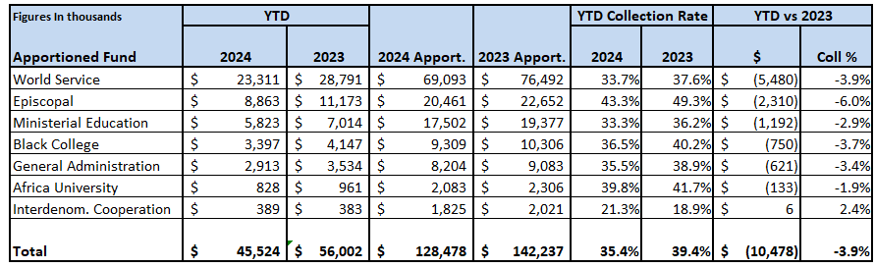
2024 Jurisdictional Apportionments Through August
2024 Apportionments to Annual Conferences are 10% lower than 2023
Overall Collection Rate = Currently 35.4%
Down 3.9% from August 2023
Forecasting a ≈ 10% decline collection rates in total this year, based on historical data
Episcopal Fund Collection Rate = Currently 43.3%
Down 6% from August 2023
Forecasting a ≈ 8% to 12% decline in collection rate in 2024 in total, based on historical data

Slide 35
Collection Rate Trend – All General Church Apportionments
2024 Apportionments to Annual Conferences are 10% lower than 2023
Overall Collection Rate = Currently 35.4%
Down 3.9% from August 2023
Forecasting a ≈ 10% decline collection rates in total this year, based on historical data
Episcopal Fund Collection Rate = Currently 43.3%
Down 6% from August 2023
Forecasting a ≈ 8% to 12% decline in collection rate in 2024 in total, based on historical data

Slide 36
2024 Jurisdictional Apportionment Collections
MONTHLY COMPARISON
Will this worsening trend continue?

Slide 37
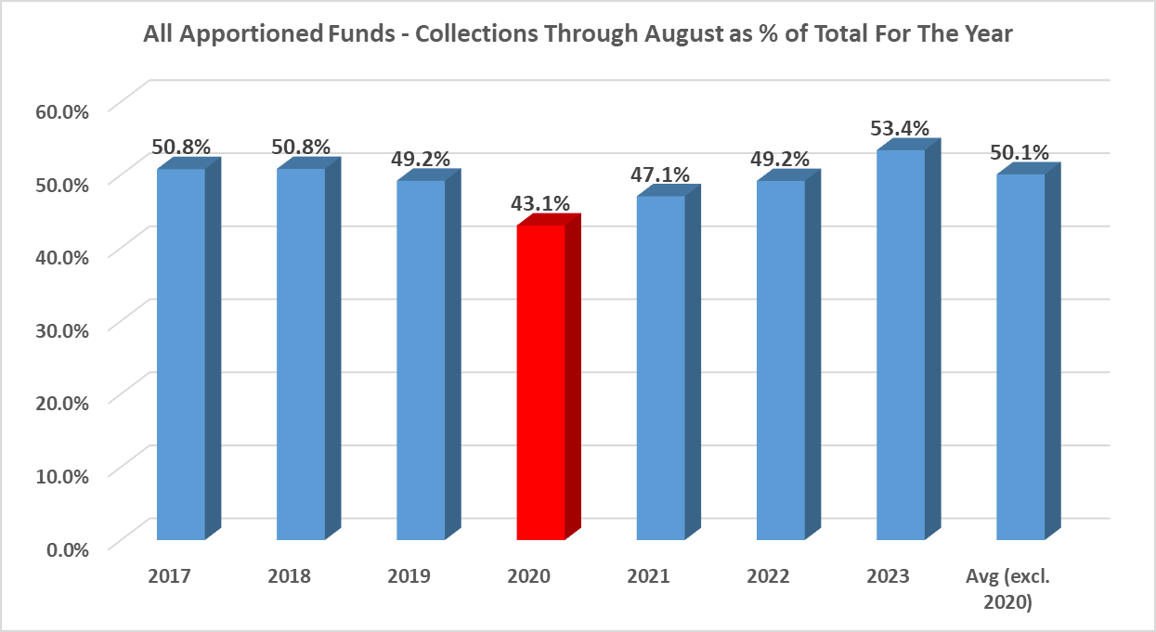
All Apportioned Funds
COLLECTION SEASONALITY TRENDS THROUGH AUGUST

Slide 38
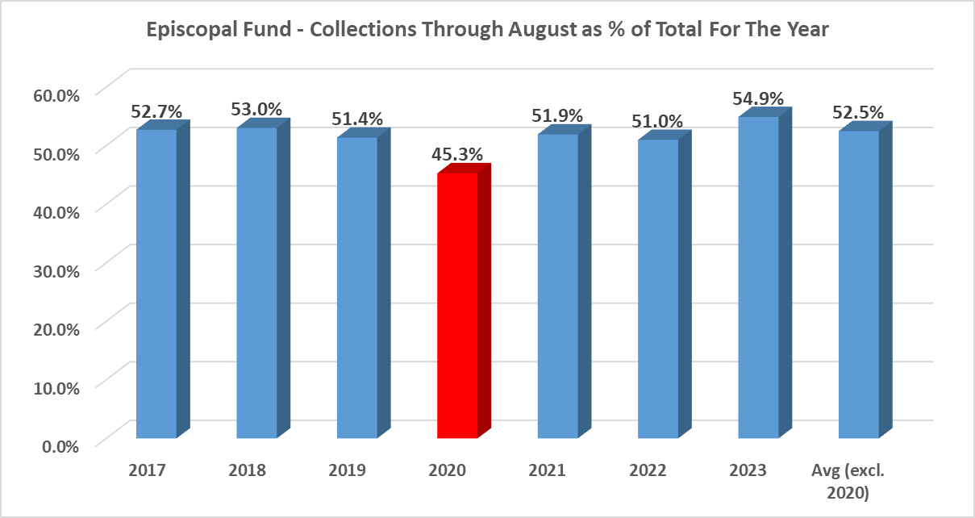
Episcopal Fund
COLLECTION SEASONALITY TRENDS THROUGH AUGUST

Slide 39
2024 Jurisdictional Apportionment Collection Projections

Slide 40
EPISCOPAL
FUND

Slide 41
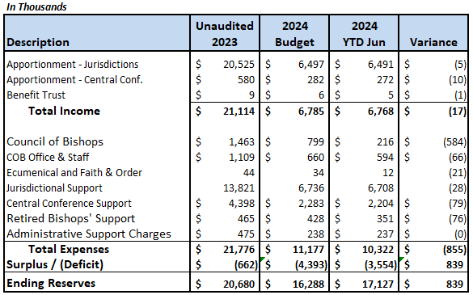
Episcopal Fund Financial Update
JUNE 2024
2024 Deficit is $838,000 better than Budget
Total Income = $17,000 less than Budget
Jurisdictional Apportionments: $5,000 less than Budget
Central Conference Apportionments: $10,000 less than Budget
Expenses $855,000 less than Budget
Meeting & Travel $700,000 lower than Budget (pending expenses)
Retiree costs – moving & insurance - $76,000
Jurisdictional & Central Conference Contingency Exp = $50k lower

Slide 42
Episcopal Fund 2025 – 2028 Quadrennial Budget
Proposed Budget November 2023
$63,008,000
Increase Proposed Percentage Rate in February 2024 | 7,500,000
Shift Allocation from General Agencies to the Episcopal Fund in February 2024 (1) | 7,500,000
Additional Increase to Base Percentage Rate at General Conference | 137,342
Budget Approved by General Conference | $78,145,342
(1) Negotiated in December 2023 in Charlotte, NC with the understanding that this is a temporary shift in funds for the 2025-2028 quadrennium

Slide 43
Episcopal Fund Reserve Trends & Projections

Slide 44
Jurisdictional Episcopal Areas
BY THE NUMBERS
Jurisdiction
Current # of Assigned Bishops
# of Assigned Bishops After 2028 Retirements
Total Allowed by GC Action
Southeastern | 9 | 4 | 5
North Central | 6 | 3 | 5
Northeastern | 6 | 5 | 5
South Central | 6 | 3 | 5
Western | 5 | 4 | 5
Total | 32 | 19 | 25

Slide 45
Future Forecast as of 9/12/24
IN THOUSANDS OF DOLLARS
Description
2028 Income As Approved by General Conference
2028 Income As Approved by GC Less $7.5 million Shared by General Agencies
Number of Jurisdictional Active Bishops | 32 | 25 | 19 | 32 | 25 | 19
Number Central Conf. Active Bishops | 22 | 22 | 22 | 22 | 22 | 22
Total Number of Active Bishops | 54 | 47 | 41 | 54 | 47 | 41
Total Income | 16,642 | 16,642 | 16,642 | 15,098 | 15,098 | 15,098
Total Expenses | 19,600 | 17,255 | 15,245 | 19,600 | 17,255 | 15,245
Annual Surplus/Deficit | (2,958) | (613) | 1,397 | (4,502) | (2,157) | (147)
4 Year Surplus/Deficit | (11,830) | (2,450) | 5,590 | (18,000) | (8,627) | (587)
Projected 2029 Beginning Fund Balance | 4,342 | 4,342 | 4,342 | 4,342 | 4,342 | 4,342
Projected 2032 Ending Fund Balance | (7,488) | 1,892 | 9,932 | (13,665) | (4,285) | 3,755

Slide 46
QUESTION
AND ANSWER
SESSION

Slide 47
CALCULATING
CONFERENCE
APPORTIONMENTS

Slide 48
Calculating Conference Apportionments
4 EASY STEPS
Calculate the percentage of administrative expenses in the total Conference budget
Calculate the Conference Apportionments Paid by local churches to be included in Net Expenditures
Calculate the total Net Expenditures in Statistics minus the Administrative amounts
Multiply total Net Expenditures * Base Rate

Slide 49
Calculating Conference Apportionments
STEP 1
The Percentage of Administrative Expenses removes any benevolences and programming costs from the apportionment paid by local churches to the Annual Conference.
Calculate the percentage of administrative expenses in the total Conference budget

Slide 50

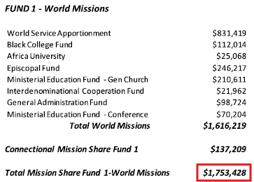
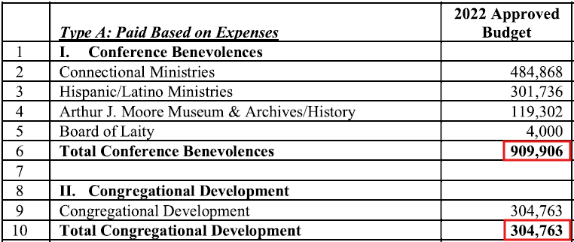
Calculating Conference Apportionments
STEP 1 EXAMPLE
Conf Administrative Expense % = (Total Conf Budget – [Programming/Benevolences]) / Total Conf Budget
Conf. Administrative Expense % = (7,632,945 – (1,753,428 + 909,906 + 304,763) ) / 7,632,945 = 61.11%

Slide 51
Calculating Conference Apportionments
STEP 2
Multiply Apportionment Paid (APPPAID – Line 29) in the local church statistics by the Conference Administrative Expense Percentage calculated in Step 1.
Calculate the Conference Apportionments Paid by local churches to be included in Net Expenditures
Net Apportionment = apppaid * Conf Administrative Expense %

Slide 52
Calculating Conference Apportionments
STEP 2
After calculating the Conference Administrative Expense Percentage, multiply that with Apportionment Paid (APPPAID) to determine the Net Apportionment value.
Net Apportionment is removing the benevolences/programming expenses from the conference budget in this calculation.
Calculate the Conference Apportionments Paid by local churches to be included in Net Expenditures
Net Apportionment = apppaid * Conf Administrative Expense %
Net Apportionment = 5,226,018 * (0.6111) = 3,193,862

Slide 53
Calculating Conference Apportionments
STEP 3
The Total Net Expenditure is the Net Apportionment, from Step 2, added with the expense lines gathered in ACStats questions listed in the table.
Total Net Expenditure = Net Apportionment + All fields in the table
Question Number | Question Name
29b | Distpaid (if applicable)
39 | penbilled
40 | hlthbilled
41a | comppast
41b | compass
41c | deacomp
42a | pasthous
42b | asschous
42c | deachous
43 | totremb
44 | totcash
45 | othcomp)
46 | (progexp
47 | operexp)
Calculate the total Net Expenditures in Statistics minus the Administrative amounts

Slide 54
Calculating Conference Apportionments
STEP 4
The final part is calculating the overall Total Apportionments for your conference.
This is just a simple equation of multiplying the Total Net Expenditures, from Step 3, by the base rate percentage.
Total Apportionments = Total Net Expenditure * Base Rate Percentage
This will give you the final value needed for Total Conference Apportionments.
Multiply Total Net Expenditures *
Base Rate Percentage

Slide 55
Calculating Conference Apportionments
STEP 4
Total Apportionments = Total Net Expenditure * Base Rate Percentage
Total Apportionments = 52,151,546 * 0.2539 = $13,241,277.53
This will give you the final value for Total Conference Apportionments.
After you calculate your final Apportionment amount, please send to DataServices@GCFA.org, along with your conference budget and highlight which values you used to calculate the Net Expenditure Percentage.
This will allow us to confirm your apportionment number calculation.
Multiply Total Net Expenditures *
Base Rate Percentage

Slide 56
Calculating Conference Apportionments
4 EASY STEPS
Calculate Conference Administrative Expense Percentage of Annual Conference total budget
Conf Administrative Expense % = (Total Conf Budget – [Programming/Benevolences]) / Total Conf Budget
Calculate Net Apportionments of the Annual Conference Budget
Net Apportionment = apppaid * Conf Administrative Expense %
Calculate the total Net Expenditures in Statistics minus the Administrative amounts
Total Net Expenditure = Net Apportionment + All fields in the table
Multiply total Net Expenditures * Base Rate Percentage
Total Apportionments = Total Net Expenditure * Base Rate Percentage

Slide 57
QUESTION
AND ANSWER
SESSION

Slide 58
Upcoming Webinars
www.GCFA.org/webinars
Common IT Scams
GuideOne Risk Management Webinar
Church Giving
Best Practices
October 16th, 2024
1 pm CDT
October 15th, 2024
12:30 pm CDT
November 13, 2024
1 pm CDT
Join United Methodist Insurance and the major carrier, GuideOne Insurance, for an essential webinar on protecting your church from the costly and disruptive effects of frozen pipes and leaks.
Join our webinar on giving best practices to optimize digital donations, manage church finances, and ensure tax compliance. Learn strategies for streamlining online giving and tracking contributions effectively.
Don’t miss this opportunity to stay ahead of cybercriminals and ensure your IT practices are secure. Register today and take the first step toward becoming scam-aware!

Slide 59
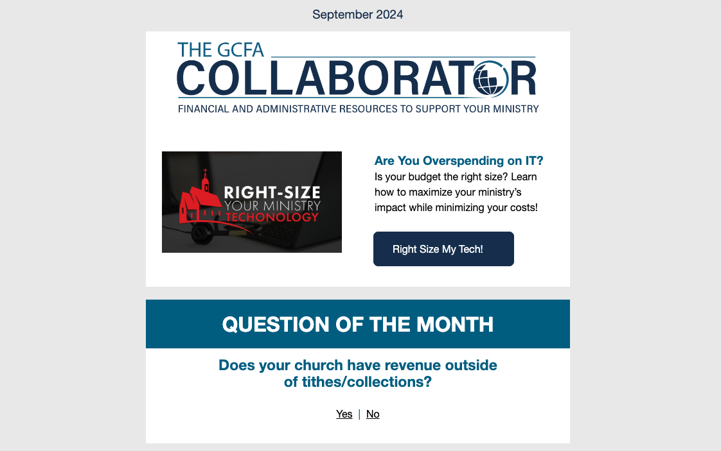

Get Free Resources
Every Month!
Scan the code to sign up for The Collaborator, our monthly newsletters with webinars, articles, downloadable resources, news and more!

Slide 60


Thank
You
www.GCFA.org
ConnectionalRelations@gcfa.org

